Slide 1
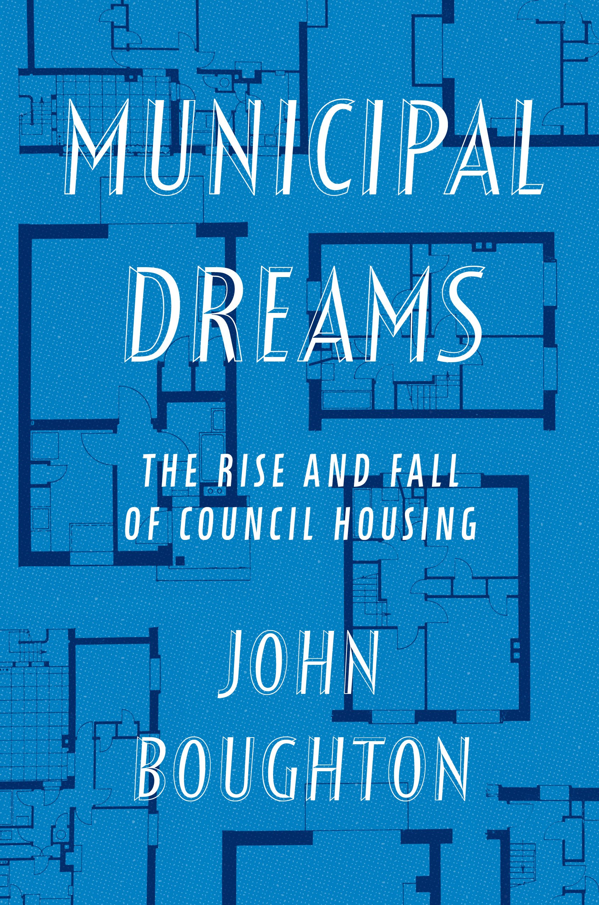
Why Build Social Housing

Slide 2
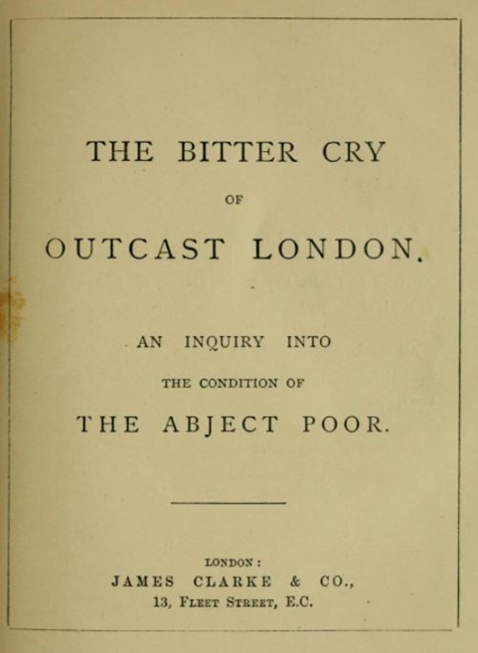
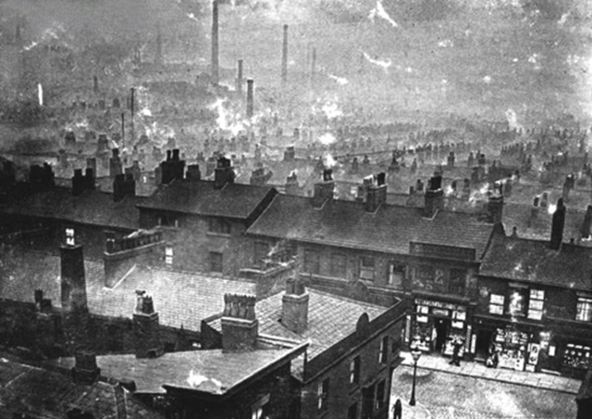
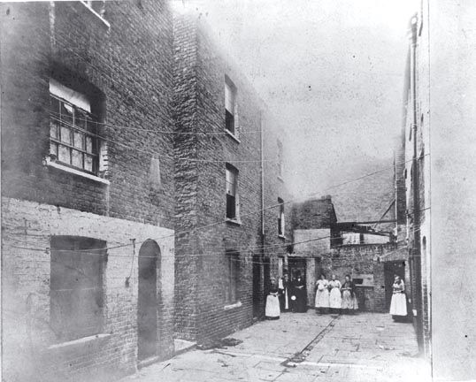
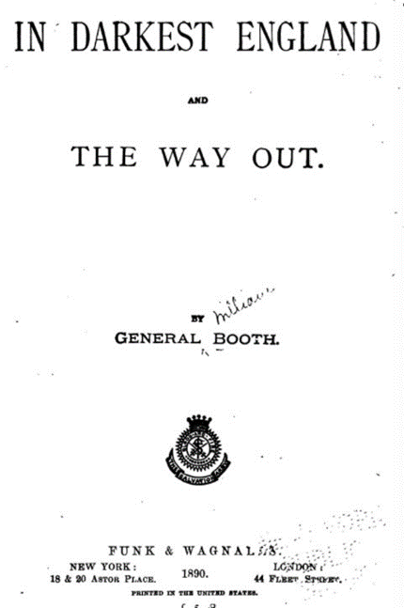
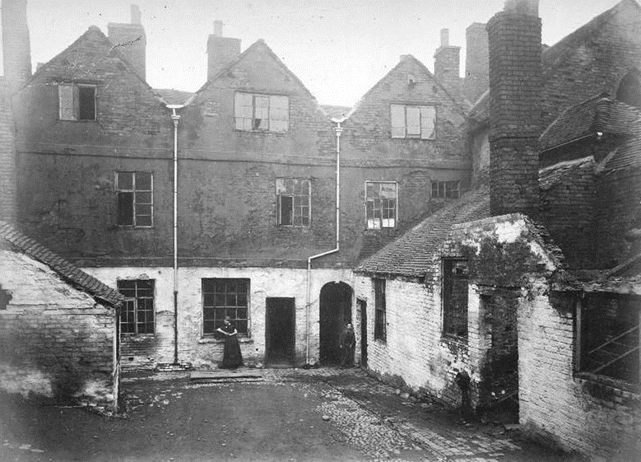
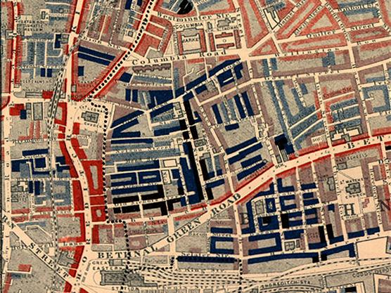
The Origins of Council Housing
Ancoats, Manchester, 1880s
Nottingham, 1883
The Old Nichol, London

Slide 3
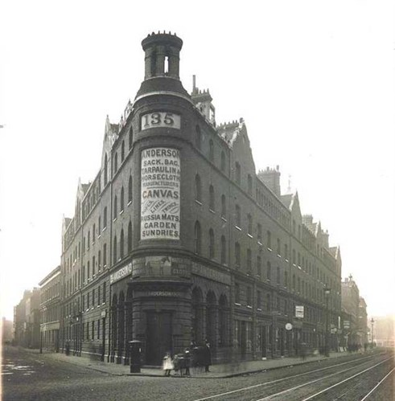
The Origins of Council Housing
First Peabody tenement block: Commercial Street, London (1864)

Slide 4
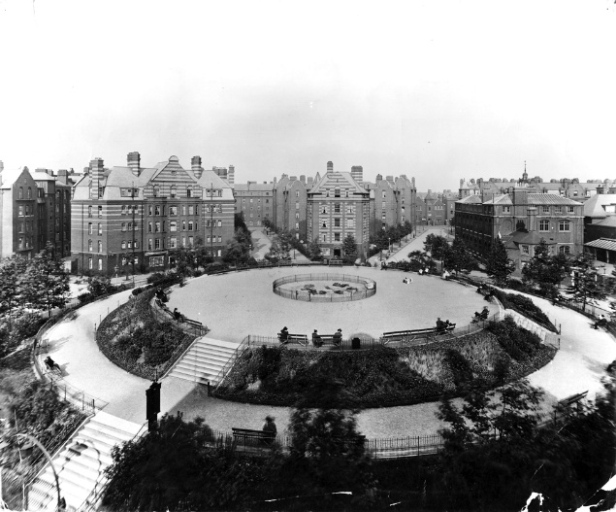
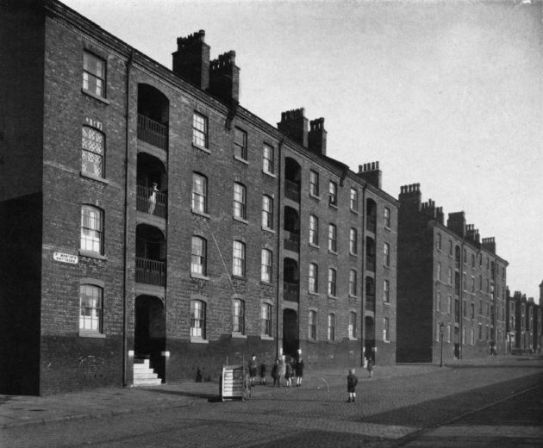
The Origins of Council Housing
St Martin’s Cottages, Liverpool (1869)
Boundary Estate, London (1900)

Slide 5
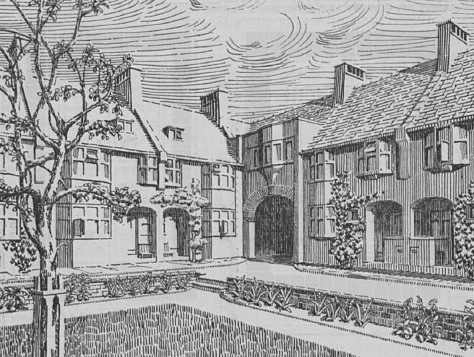
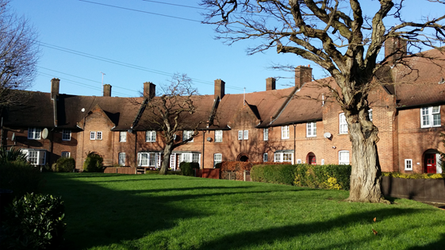
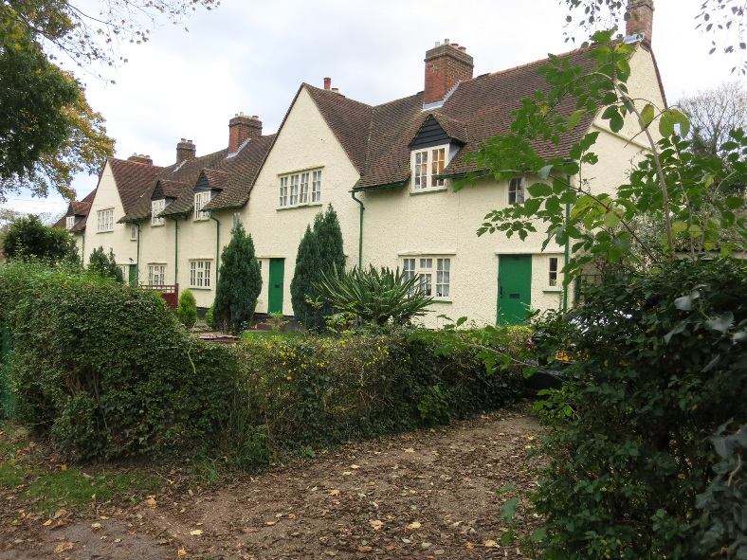
The Debate over Form
Raymond Unwin, Cottage Plans and Common Sense (1902)
Old Oak Estate (1909)
Rushby Mead, Letchworth (1911)

Slide 6
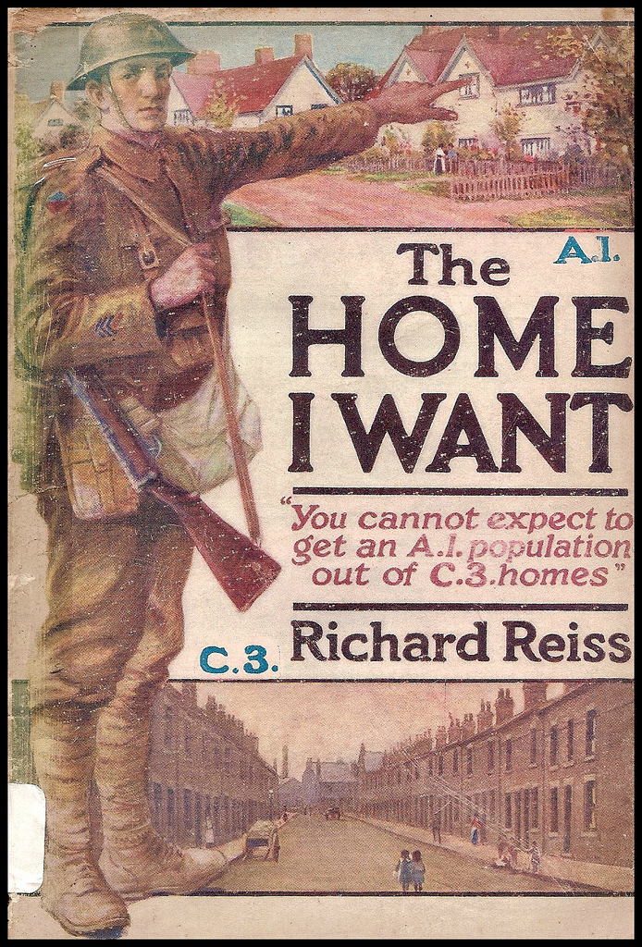
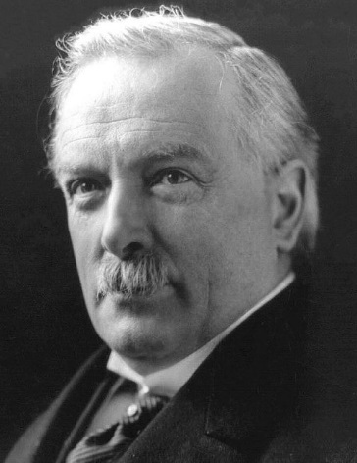
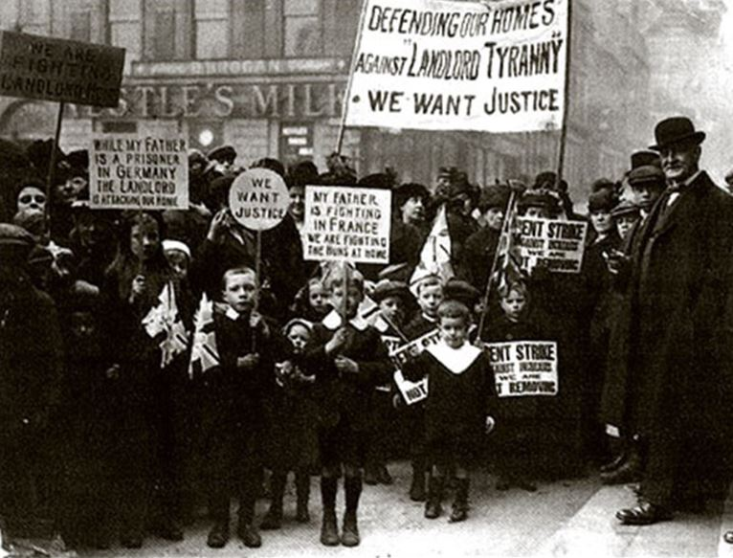
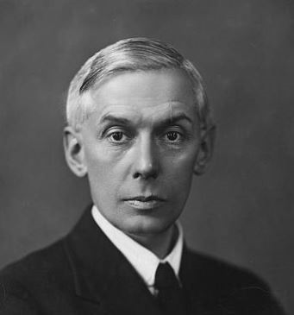
The Impact of War
‘What is our task? To make Britain a fit country for heroes to live in’
Lloyd George, 1918
Christopher Addison

Slide 7
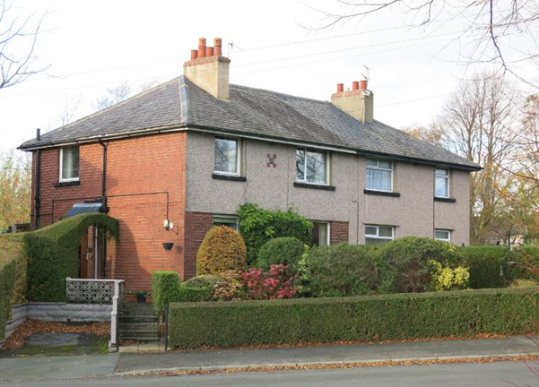
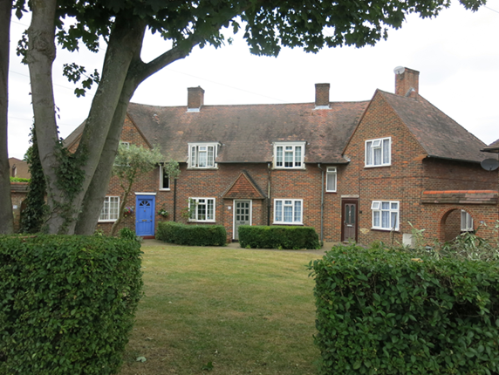
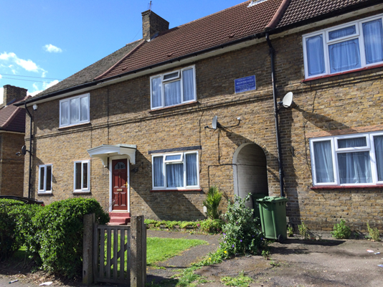
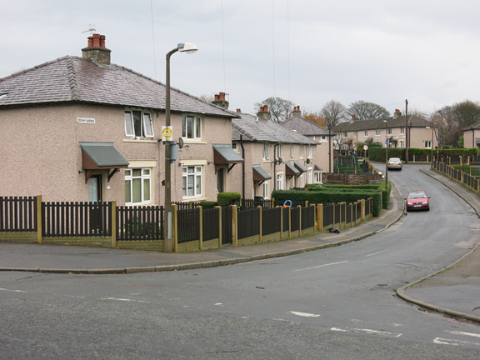
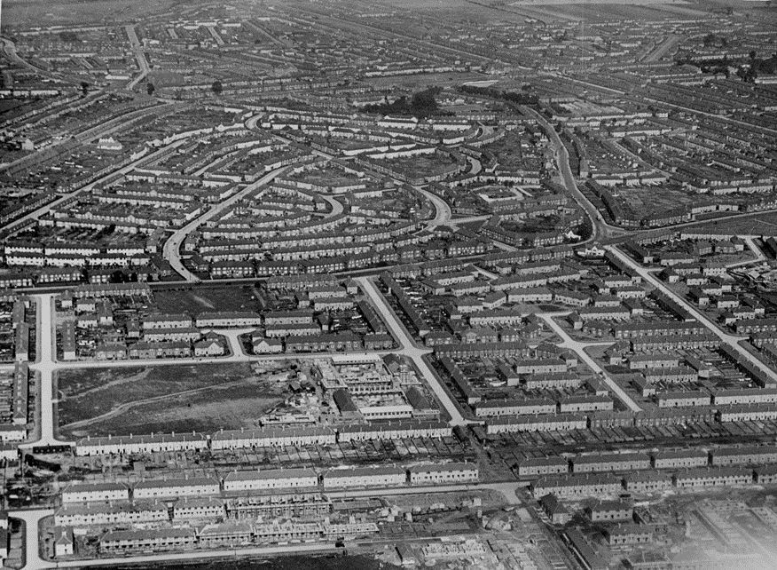
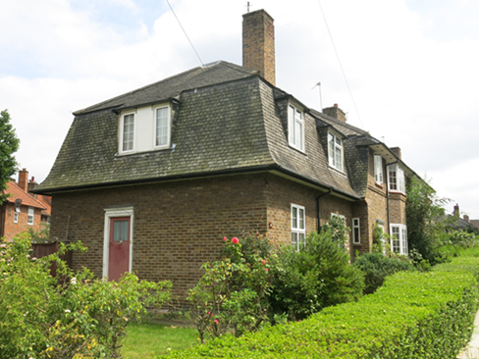
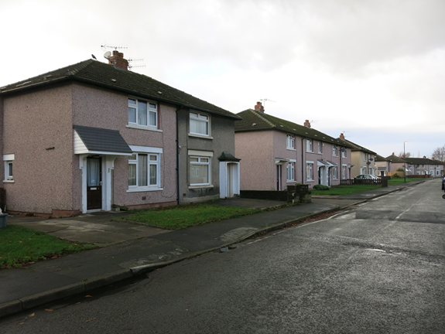
The Evolution of Interwar Council Housing
Interwar Lancaster
Dover House Estate, Putney (1919)
Becontree, East London (1921)

Slide 8
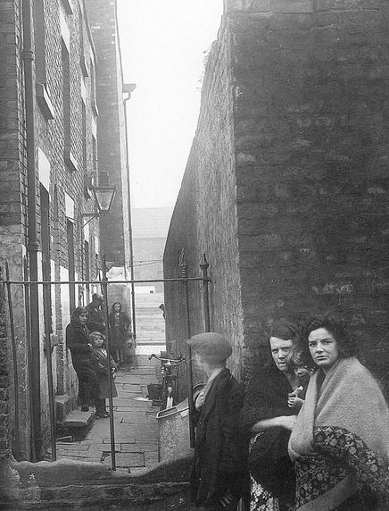
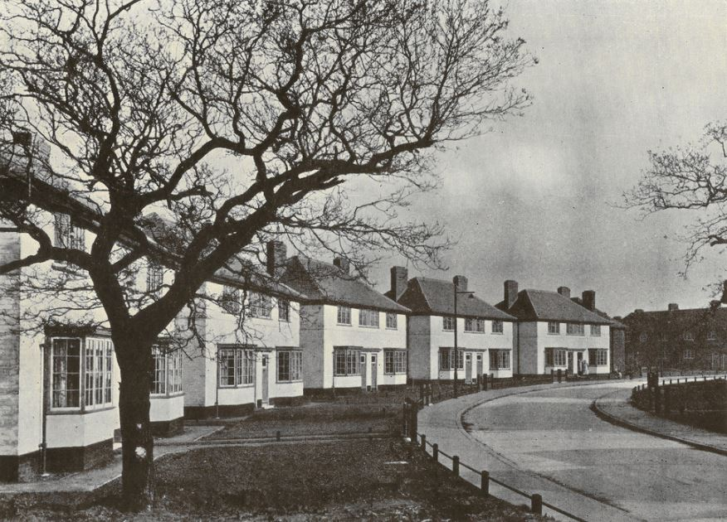
Housing for the Better-Off Working Class
She came from Great Homer Street and when I first saw her, I thought, oh dear, what is she going to be like. She was wearing a shawl, you see, but she tried to improve herself by asking how to say certain words and I remember when she bought her first coat, she was so proud she ran in to show me. She never wore the shawl after that ...
I think living among decent people pulled that type up somehow.
Not everyone could get a house in Wythenshawe. Before we got one an official from the Town Hall wanted to know all about us…We had to prove we were good tenants. We heard that some people were from the slums but we never met any of them.

Slide 9
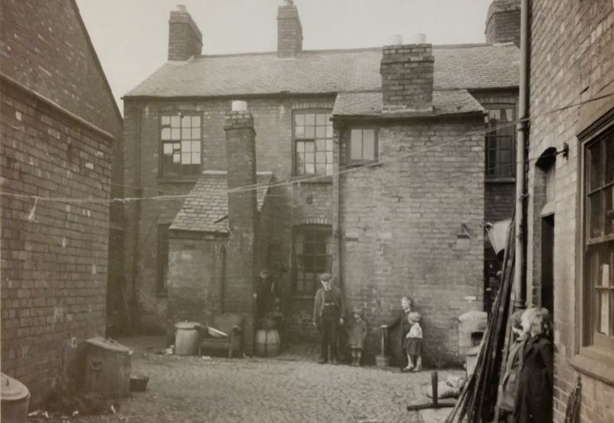
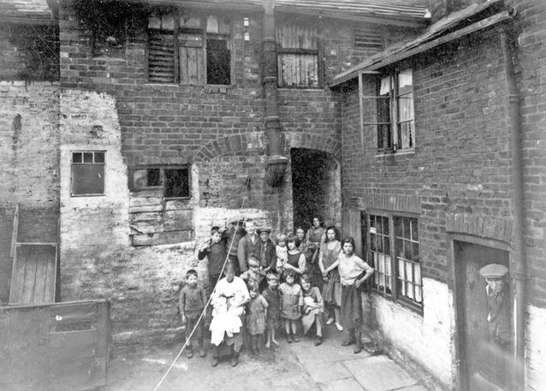
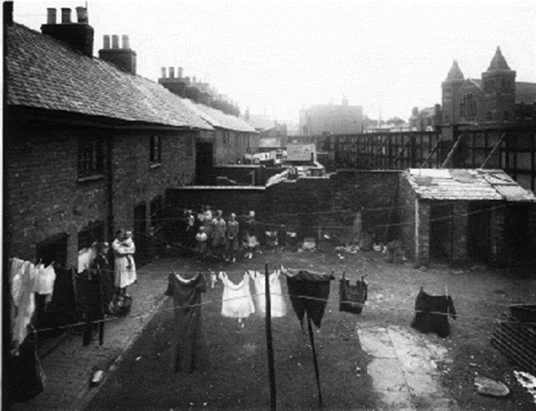
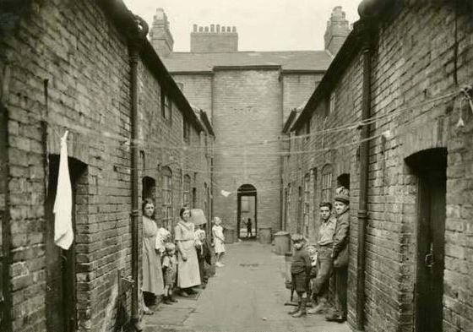
The Persistence of the Slums
Leicester, 1930s
Sheffield, 1920s
Nottingham, 1931

Slide 10
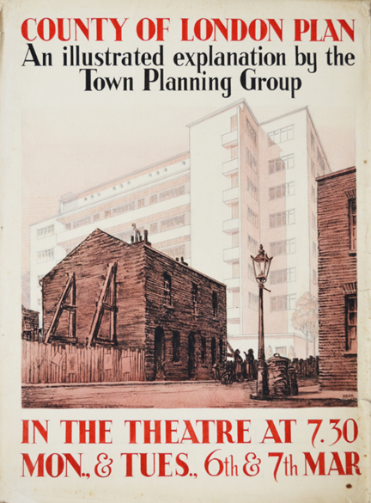
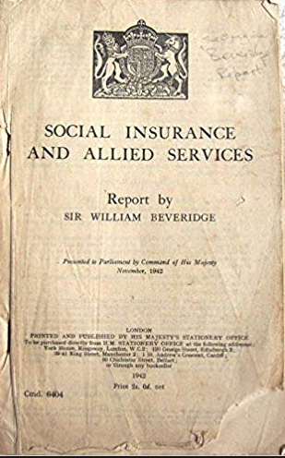
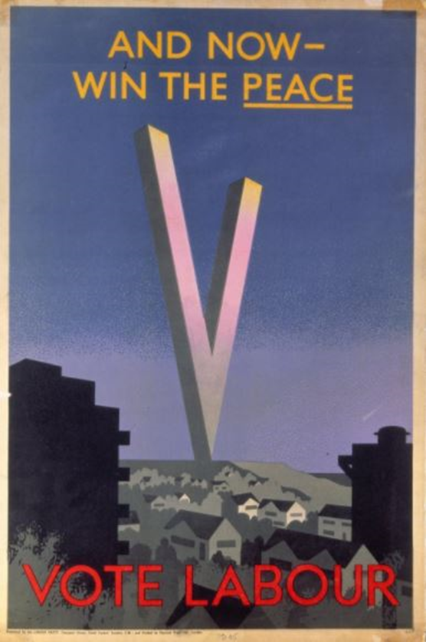
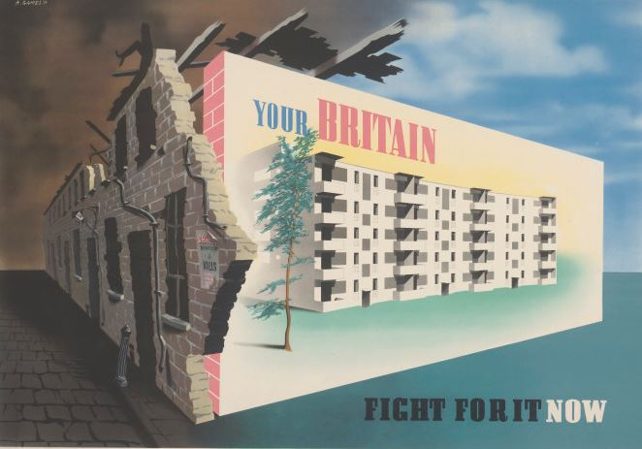
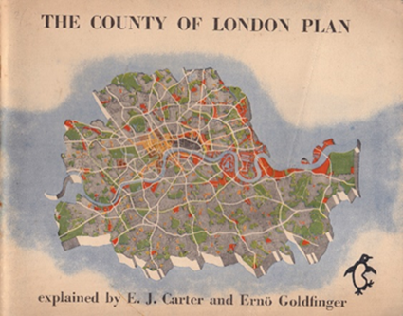
The Impact of War

Slide 11
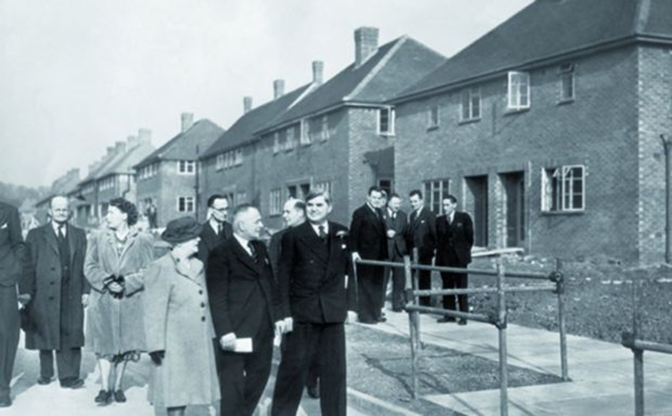
Post-War Social Democracy
Mixed communities and ‘general needs’
You have castrated communities. You have colonies of low income people, living in houses provided by the local authorities, and you have the higher income groups living in their own colonies. This segregation of the different income groups is a wholly evil thing, from a civilised point of view…
We should try to introduce what was always the lovely feature of English and Welsh villages, where the doctor, the grocer, the butcher and the farm labourer all lived in the same street –the living tapestry of a mixed community.
Nye Bevan

Slide 12
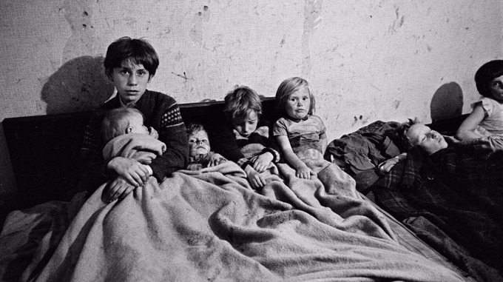
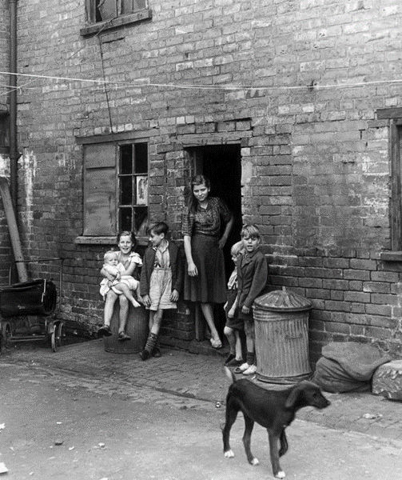
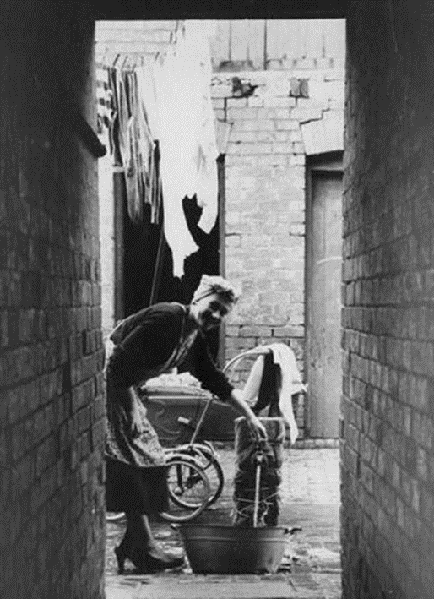
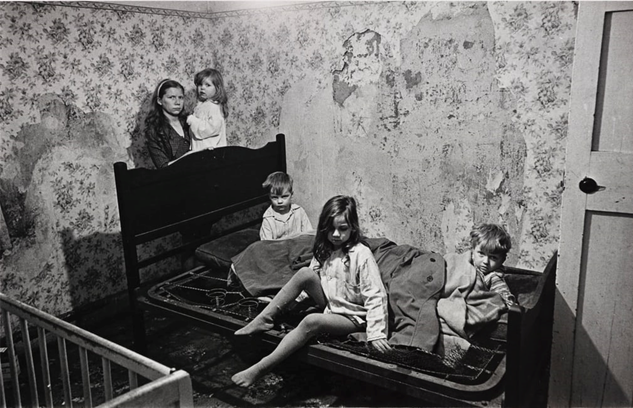
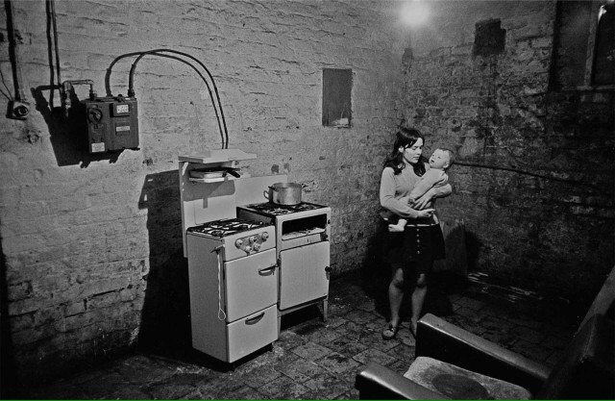
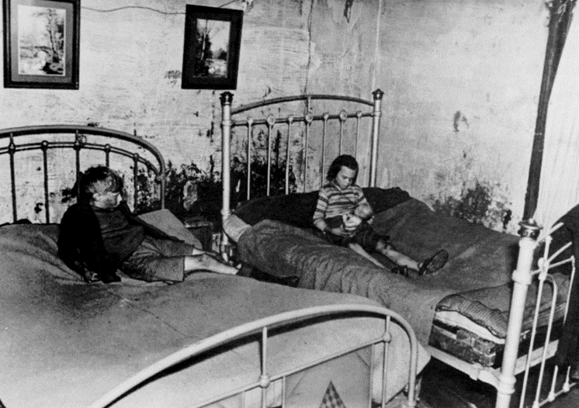
The Persistence of the Slums
Birmingham and Manchester (Images by Nick Hedges for Shelter, c1968)
Leicester, 1950s

Slide 13
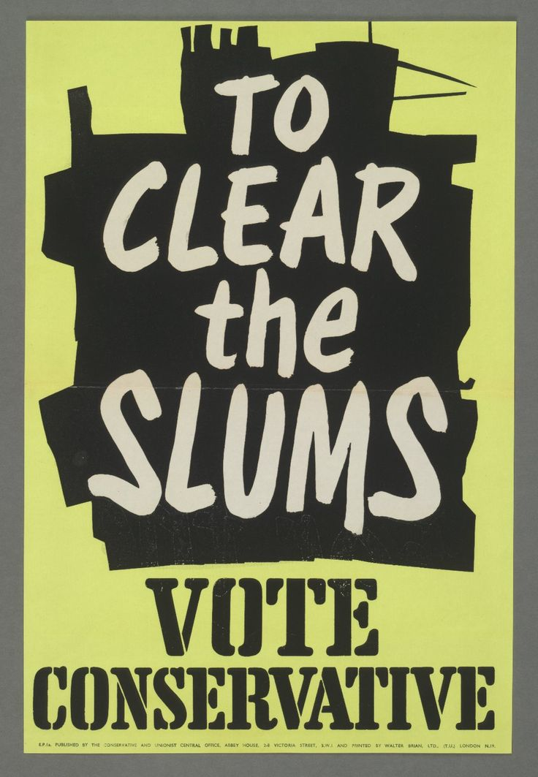
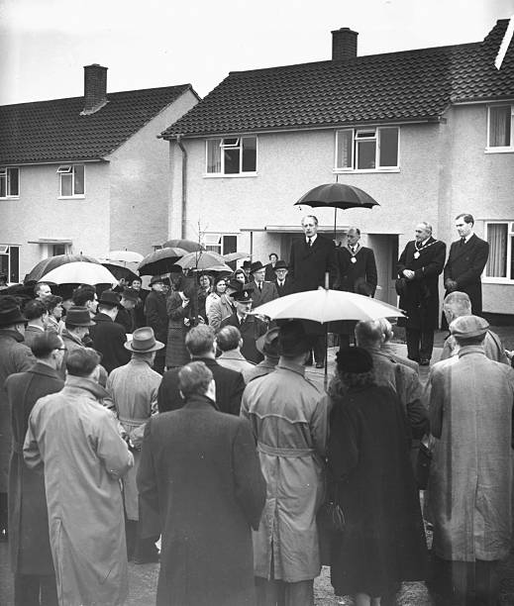
Post-War Conservatism
Housing is the first of the social services. It is also one of the keys to increased productivity. Work, family life, health and education are all undermined by overcrowded homes. Therefore a Conservative and Unionist Government will give housing a priority second only to national defence.
Conservative Party manifesto, 1951

Slide 14
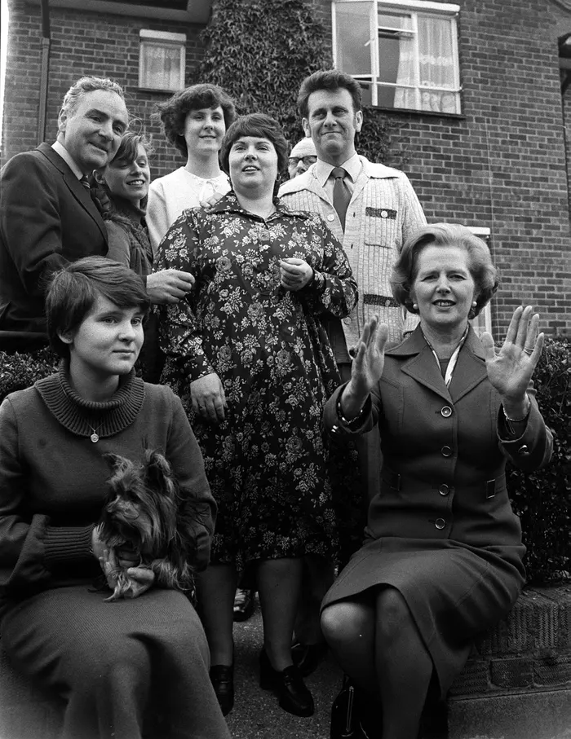
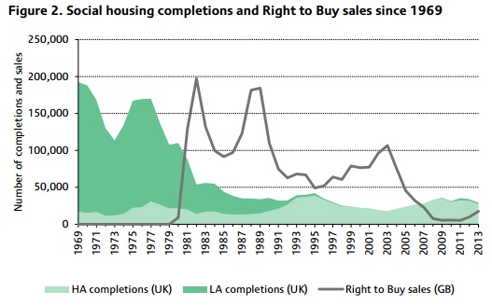
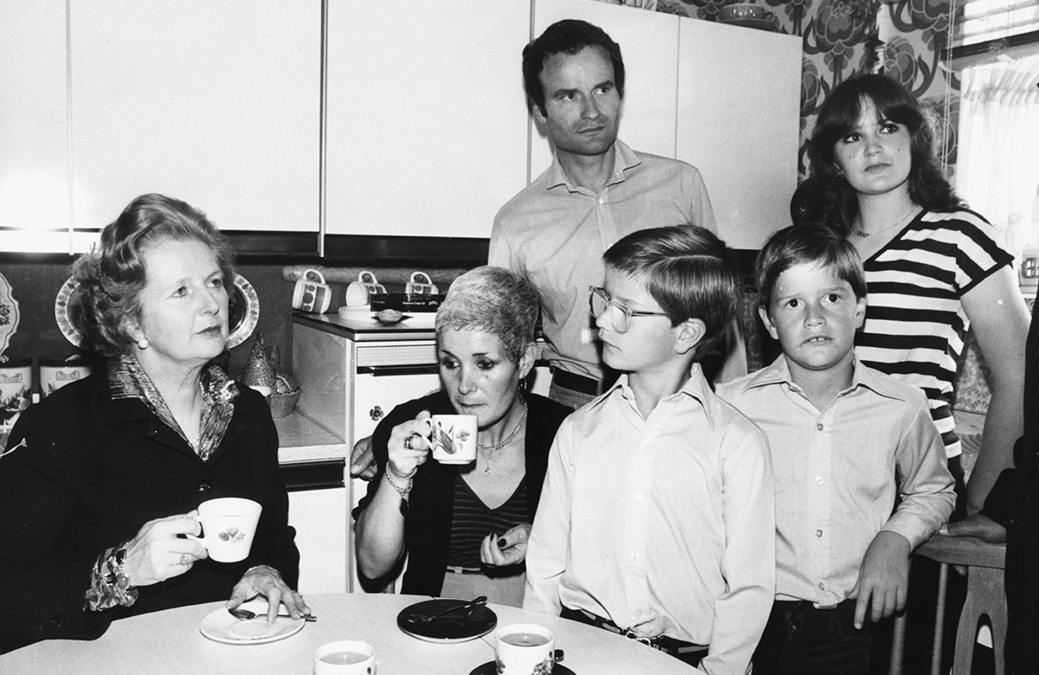
Since 1979
Right to Buy

Slide 15
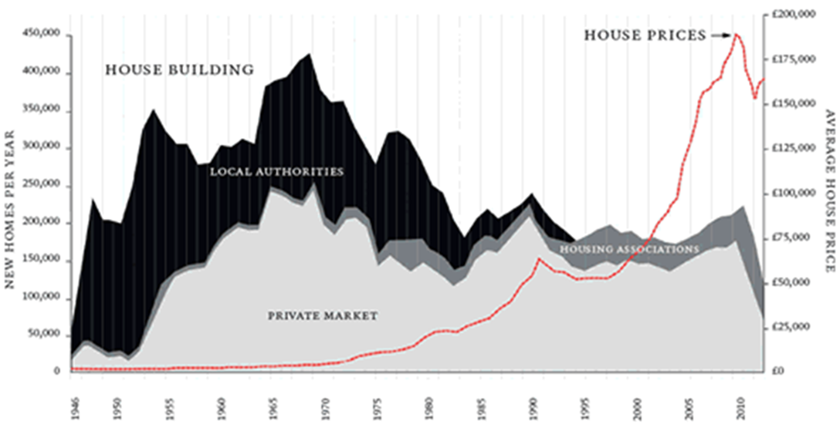
Why social housing?

